Slide 1
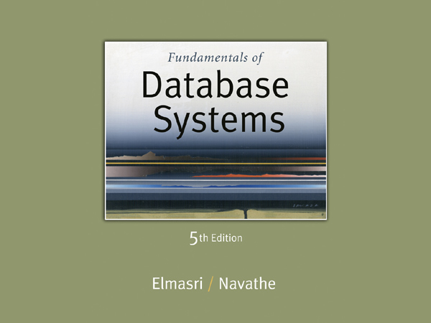

Slide 2
Basic Steps in Query Processing
1. Parsing and translation
2. Optimization
3. Evaluation

Slide 3
0. Introduction to Query Processing (1)
Query optimization:
The process of choosing a suitable execution strategy for processing a query.
Two internal representations of a query:
Query Tree
Query Graph

Slide 4
1. Translating SQL Queries into Relational Algebra (1)
An SQL query is first translated into an equivalent extended relational algebra expression—represented as a query tree data structure—that is then optimized.
SQL queries are decomposed into query blocks.
Query block:
The basic unit that can be translated into the algebraic operators and optimized.
A query block contains a single SELECT-FROM-WHERE expression, as well as GROUP BY and HAVING clause if these are part of the block.
Nested queries within a query are identified as separate query blocks.
Aggregate operators in SQL must be included in the extended algebra.

Slide 5
Translating SQL Queries into Relational Algebra (2)
SELECT LNAME, FNAME
FROM EMPLOYEE
WHERE SALARY > ( SELECT MAX (SALARY)
FROM EMPLOYEE
WHERE DNO = 5);
SELECT LNAME, FNAME
FROM EMPLOYEE
WHERE SALARY > C
SELECT MAX (SALARY)
FROM EMPLOYEE
WHERE DNO = 5
π_{LNAME, FNAME} (σ_{SALARY>C}(EMPLOYEE))
G_{MAX SALARY} (σ_{DNO=5} (EMPLOYEE))

Slide 6
2. Algorithms for External Sorting (1)
Sorting is one of the primary algorithms used in query processing.
Example: In ORDER BY-clause, duplicate elimination in PROJECT operation, sort-merge algorithms used for JOIN etc.
External sorting:
Refers to sorting algorithms that are suitable for large files of records stored on disk that do not fit entirely in main memory, such as most database files.
Sort-Merge strategy:
Starts by sorting small subfiles (runs) of the main file and then merges the sorted runs, creating larger sorted subfiles that are merged in turn.
Sorting phase: n_{R} = ⎡(b/n_{B})⎤
Merging phase: d_{M} = Min (n_{B}-1, n_{R}); n_{P} = ⎡(log_{dM}(n_{R}))⎤
n_{R}: number of initial runs; b: number of file blocks;
n_{B}: available buffer space; d_{M}: degree of merging;
n_{P}: number of passes.

Slide 7
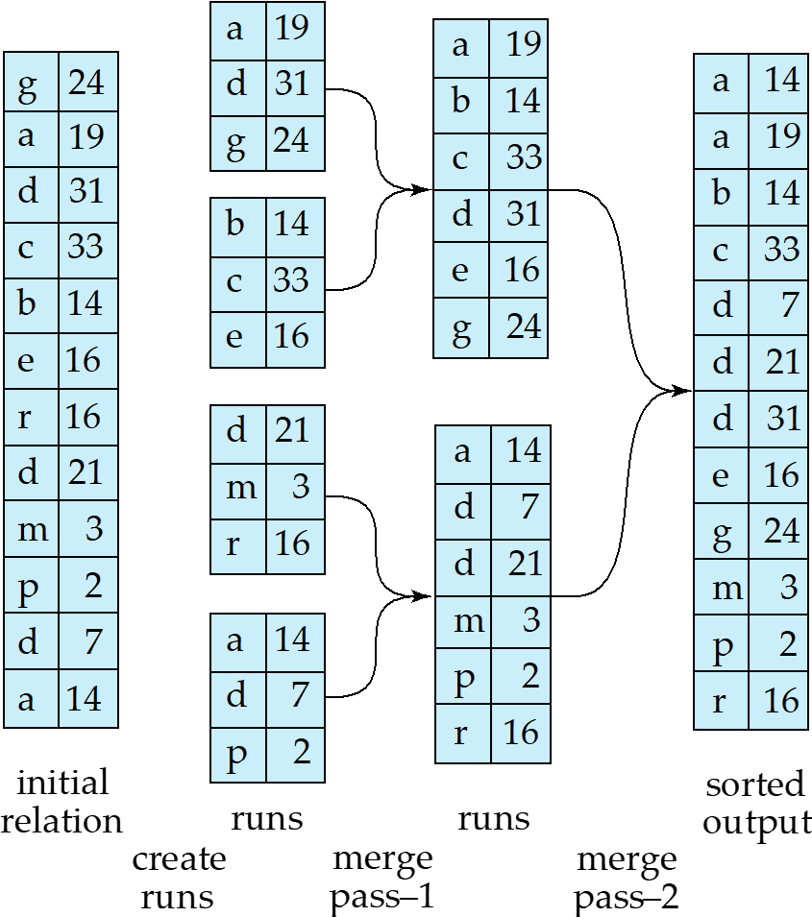

Slide 8
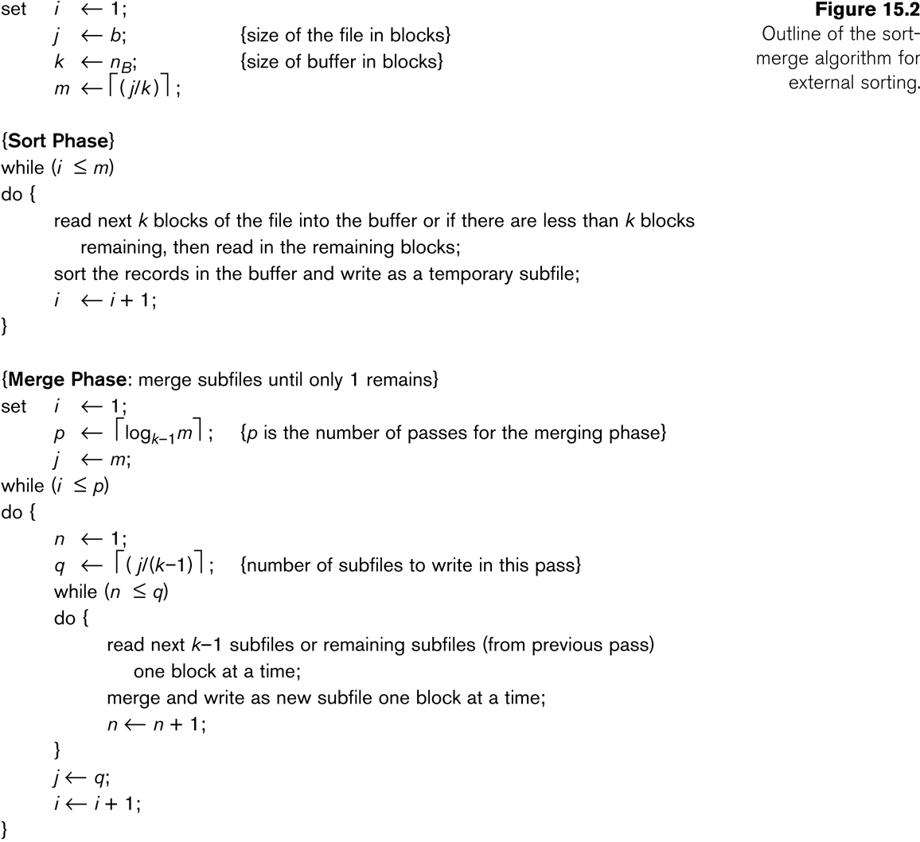
Algorithms for External Sorting (2)

Slide 9
3. Algorithms for SELECT and JOIN Operations (1)
Implementing the SELECT Operation
Examples:
(OP1): σ _{SSN='123456789'} (EMPLOYEE)
(OP2): σ _{DNUMBER>5}(DEPARTMENT)
(OP3): σ _{DNO=5}(EMPLOYEE)
(OP4): σ DNO=5 AND SALARY>30000 AND SEX=F(EMPLOYEE)
(OP5): σ _{ESSN=123456789 AND PNO=10}(WORKS_ON)

Slide 10
Algorithms for SELECT and JOIN Operations (2)
Implementing the SELECT Operation (contd.):
Search Methods for Simple Selection:
S1 Linear search (brute force):
Retrieve every record in the file, and test whether its attribute values satisfy the selection condition.
S2 Binary search:
If the selection condition involves an equality comparison on a key attribute on which the file is ordered, binary search (which is more efficient than linear search) can be used. (See OP1).
S3 Using a primary index or hash key to retrieve a single record:
If the selection condition involves an equality comparison on a key attribute with a primary index (or a hash key), use the primary index (or the hash key) to retrieve the record.

Slide 11
Algorithms for SELECT and JOIN Operations (3)
Implementing the SELECT Operation (contd.):
Search Methods for Simple Selection:
S4 Using a primary index to retrieve multiple records:
If the comparison condition is >, ≥, <, or ≤ on a key field with a primary index, use the index to find the record satisfying the corresponding equality condition, then retrieve all subsequent records in the (ordered) file.
S5 Using a clustering index to retrieve multiple records:
If the selection condition involves an equality comparison on a non-key attribute with a clustering index, use the clustering index to retrieve all the records satisfying the selection condition.
S6 Using a secondary (B+-tree) index:
On an equality comparison, this search method can be used to retrieve a single record if the indexing field has unique values (is a key) or to retrieve multiple records if the indexing field is not a key.
In addition, it can be used to retrieve records on conditions involving >,>=, <, or <=. (FOR RANGE QUERIES)

Slide 12
Algorithms for SELECT and JOIN Operations (4)
Implementing the SELECT Operation (contd.):
Search Methods for Simple Selection:
S7 Conjunctive selection:
If an attribute involved in any single simple condition in the conjunctive condition has an access path that permits the use of one of the methods S2 to S6, use that condition to retrieve the records and then check whether each retrieved record satisfies the remaining simple conditions in the conjunctive condition.
S8 Conjunctive selection using a composite index
If two or more attributes are involved in equality conditions in the conjunctive condition and a composite index (or hash structure) exists on the combined field, we can use the index directly.

Slide 13
Algorithms for SELECT and JOIN Operations (5)
Implementing the SELECT Operation (contd.):
Search Methods for Complex Selection:
S9 Conjunctive selection by intersection of record pointers:
This method is possible if secondary indexes are available on all (or some of) the fields involved in equality comparison conditions in the conjunctive condition and if the indexes include record pointers (rather than block pointers).
Each index can be used to retrieve the record pointers that satisfy the individual condition.
The intersection of these sets of record pointers gives the record pointers that satisfy the conjunctive condition, which are then used to retrieve those records directly.
If only some of the conditions have secondary indexes, each retrieved record is further tested to determine whether it satisfies the remaining conditions.

Slide 14
Algorithms for SELECT and JOIN Operations (7)
Implementing the SELECT Operation (contd.):
Whenever a single condition specifies the selection, we can only check whether an access path exists on the attribute involved in that condition.
If an access path exists, the method corresponding to that access path is used; otherwise, the “brute force” linear search approach of method S1 is used. (See OP1, OP2 and OP3)
For conjunctive selection conditions, whenever more than one of the attributes involved in the conditions have an access path, query optimization should be done to choose the access path that retrieves the fewest records in the most efficient way.
Disjunctive selection conditions

